Slide 1
VICH Residue Guidelines
Data Requirements for setting Withdrawal Periods
Stefan Scheid, Federal Office of Consumer Protection and Food Safety (BVL), Berlin, Germany

Slide 2
Disclaimer
These slides have been provided for training purposes only. The presenter has made every attempt to ensure that they are consistent with relevant VICH guideline(s).
As always, the original Guideline(s) should be used as the primary source of information for working with regulators.

Slide 3
VICH EWG Metabolism and Residue Kinetics
VICH Steering Committee
OIE
VICH Secretariat
VICH Outreach Forum
Ad Hoc Task Forces
VICH EWG “Metabolism Residue Kinetics”
Expert working
Group
Expert working
Group
E
Expert working
Group
Group
Expert working
Group Group

Slide 4
VICH EWG Metabolism and Residue Kinetics
The Expert Working Group (EWG) on “Metabolism and Residue Kinetics” was founded at the 16th VICH Steering Committee meeting in May 2005
EWG took up work its work in 2005 when the main topics were identified
Subsequently, 4 basic residues guidelines covering data requirements for both maximum residue limits (MRL) and withdrawal times for veterinary drugs were completed
The 4 basic guidelines are implemented
Two additional guidelines on residue studies in bees/honey and aquatic species will be implemented during 2019

Slide 5
VICH Metabolism & Residue Kinetics GLs – the first 4 GLs
Metabolism study to determine the quantity and identify the nature of residues
  VICH GL46 (MRK) - February 2011 - Implemented in February 2012
Comparative metabolism studies in laboratory animals
  VICH GL47 (MRK) - February 2011 - Implemented in February 2012
Marker residue depletion studies to establish product withdrawal periods
  VICH GL48(R) (MRK) - February 2015 - Implemented in January 2016
Validation of analytical methods used in residue depletion studies
  VICH GL49(R) (MRK) - January 2015 - Implemented in January 2016
Notes:
VICH MRK GLS

Slide 6
VICH Metabolism & Residue Kinetics GLs
- 2 additional GLs on specialised topics
VICH GL 56: Study design recommendations for residue studies in honey for establishing MRLs and withdrawal periods (MRK) – for Implementation by June 2019
VICH GL 57: Marker residue depletion studies to establish product withdrawal periods in aquatic species - – for Implementation by February 2020
The 2 GLs are “spin-offs” from VICH GL 48 (“Marker residue depletion studies”)
It turned out when drafting GL 48 that studies in bees and aquatic species are too different from studies in mammalian/avian species and should be considered separately
Notes:
VICH MRK GLS

Slide 7
Expected benefits from harmonised VICH Metabolism & Residue Kinetics GLs
VICH GLs reflect the collective knowledge and long-term practical experience of residue experts from both industry and regulatory authorities
Generation of high quality and “State-of-the-Art” residue and exposure data
Periodic review of adopted VICH guidelines (at least every 5 years) to keep them up-to-date
Studies according to VICH can be re-used in different regions
- fewer studies needed, less animals treated and sacrificed (in total) (“3Rs” principles); less and better use of resources
High-level food safety for consumers
VICH GLs 46-49 are setting standards and are also accepted by other international bodies (e.g. JECFA)

Slide 8
Introduction of Terms and Concepts: MRL, Withdrawal period etc
Withdrawal period is the time from when the animal was last treated with the drug to when the animal can be slaughtered for food or the animal’s milk or eggs can be used for human consumption (precise definition may vary in different regions)
Withdrawal periods are typically based on depletion of a residue below a Maximum Residue Limit
The Maximum Residue Limit (MRL) is the maximum concentration of a veterinary drug residue that is legally permitted or recognized as acceptable in or on a food as set by a national or regional regulatory authority
Total residue of a drug in edible tissues is the sum of the parent drug and all metabolites as determined in radiolabeled studies or other equivalent studies.
Residue of concern refers to the total amount of residues that have relevance to the ADI established for the veterinary drug
The term ‘tolerance’ (instead of MRL) is used in some jurisdictions but this is (in most cases) synonymous with MRL

Slide 9
Introduction of Terms and Concepts: MRL, Withdrawal period etc
The marker residue is that residue whose concentration is in a known relationship to the concentration of total residue or residue of concern in an edible tissue
Maximum Residue Limits (MRLs) are defined for a certain concentration of a “marker residue”
Marker residue is an “indicator” for “total residue/residues of concern” in an edible tissue
The marker residue is:
  indicative of the presence of residues over a reasonably long time following administration of the drug (ideally beyond the approved withdrawal period)
  can be analyzed by (commercially available) analytical methods
  its relation to the residue of concern is known at any time
The marker residue is also used for control of residues in enforcement and residue monitoring

Slide 10
Introduction of Terms and Concepts: MRL, Withdrawal period etc
The 4 basic GLs are satisfying all data requirements for both setting MRLs and withdrawal periods in edible products in the VICH regions.
The data generated according to these GLs are suitable to:
VICH 46: Identify total residues/residue of concern of a drug, its metabolic profiles in target species (major/minor metabolites), to “identify” the marker residue and to recommend an MRL to be observed when setting withdrawal periods
VICH 47: links the observed residue profile (exposure) to the hazard profile (toxicity) via comparative metabolism and, this comparison “validates” the ADI for its use to assess residues in the food species under consideration
VICH 48: data allow to establish a withdrawal period based on the marker residue depletion in meat, milk, eggs
VICH 49: data allow to assess the validity of analytical methods used in residue studies

Slide 11
VICH GL 48: “Marker residue
depletion” and withdrawal period
Scope:
Outlines the design for studies to demonstrate the depletion of the marker residue upon cessation of drug treatment to the regulatory safe level (e.g. MRL, tolerance)
Encompasses studies in most common species, cattle, pig, sheep and poultry as well as milk and eggs (honey and fish are dealt with in separate GLs)
The principles of this guidance can also be applied to other studies and animal species as well

Slide 12
VICH GL 48: “Marker residue
depletion” and withdrawal period
Study design
Edible Tissues:
Animals healthy and, preferably, not previously medicated
Test article representative of the commercial formulation
Treatment consistent with the intended product label (e.g. max. dose and duration)
One residue depletion study (for tissues) performed for each species
If product administered via more than one parenteral route (IM, SC, IV), separate marker residue depletion study for each route
Number of animals large enough to allow a meaningful assessment
  Mammals: at least 16 animals with four animals at four appropriately distributed time intervals are recommended
  Poultry: at least 6 samples at each slaughter time for tissue residue studies
Injectables: multiple injections alternately between left and right sides

Slide 13
VICH GL 48: “Marker residue
depletion” and withdrawal period
Sample collection from animals (harmonised approach - all regions)
Edible tissue type | Species / Sample description
 | Cattle / Sheep | Swine | Poultry
Muscle | Loin | Loin | Breast
Injection site muscle | Core of muscle tissue ~500 g 10 cm diameter x 6 cm deep for i.m. 15 cm diameter x 2.5 cm deep for s.c. | Core of muscle tissue ~500 g 10 cm diameter x 6 cm deep for i.m. 15 cm diameter x 2.5 cm deep for s.c. | Collect sample from entire site of injection, e.g. chicken whole neck, whole breast or whole leg Larger birds: Not to exceed 500 g
Liver | Cross-section of lobes | Cross-section of lobes | Entire
Kidney | Composite from combined kidneys | Composite from combined kidneys | Composite from combined kidneys
Fat | Peri-renal | NA | NA
Skin / fat | NA | Skin with fat in natural proportions | Skin with fat in natural proportions

Slide 14
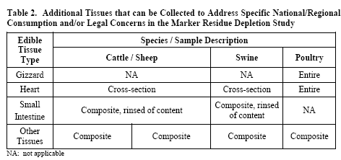
VICH GL 48: “Marker residue
depletion” and withdrawal period
Additional tissues
Additional tissues can be collected to address specific national/regional consumption habits and/or legal concerns
For purposes of this guidance, one of the additional tissue from Table 2 should be selected
This would typically be the additional tissue with the highest residues or the slowest depletion rate

Slide 15
VICH GL 48: “Marker residue
depletion” and withdrawal period
Specific aspects - Injection Sites
Samples should be collected from the last injection site (or sites) which should be the site of the animal that had the higher number of injections
The primary core sample should target 500 g ± 20%
Quality assurance of sampling
EU preferred:
  Additional ring sample (300 g ± 20%) around the primary core sample
Other quality assurance sampling strategies also possible, if appropriate to ensure that the collected tissue actually encompasses the injection site

Slide 16

VICH GL 48: “Marker residue
depletion” and withdrawal period
Sampling at injection sites
(one of several options to ensure correct sampling)
Core injection site
(ca. 500 g)
Surrounding (ring) injection site
(ca. 300 g)

Slide 17

VICH GL 48: “Marker residue
depletion” and withdrawal period
Specific aspects – “Zero” Day Withdrawal Time Study Design
For products administered as one treatment or as several treatments (i.e. daily for 3-5 days) or for continuous use products in which residues have reached steady state, a single time point study may be sufficient to qualify for 0-day tissue withdrawal period
Sampling time chosen for this study should be consistent with the peak residue concentrations (e.g. observed during the total residue depletion study according to VICH GL46 or other relevant information)
Increased animal numbers
  Large Animals: 6 animals
  Poultry: 12 birds
A time between “practical” zero of 3 hrs (minimal transit time) and a maximum time ≤ 12 hrs usually qualifies as 0-days
17

Slide 18
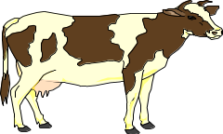
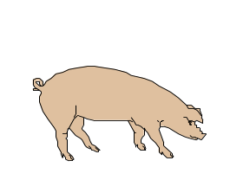
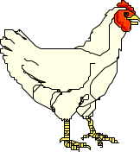
Example for assessment of data
(outside the scope of VICH 48)
Terminal Depletion Phase (typically 1st Order Kinetics)
Conc.
.
.
.
C_{t} = C₀ . e ^{– kel • t}
.
.
.
C_{t} < MRL
.
.
.
.
.
.
Treatment
Withdrawal
Period
Food Production

Slide 19
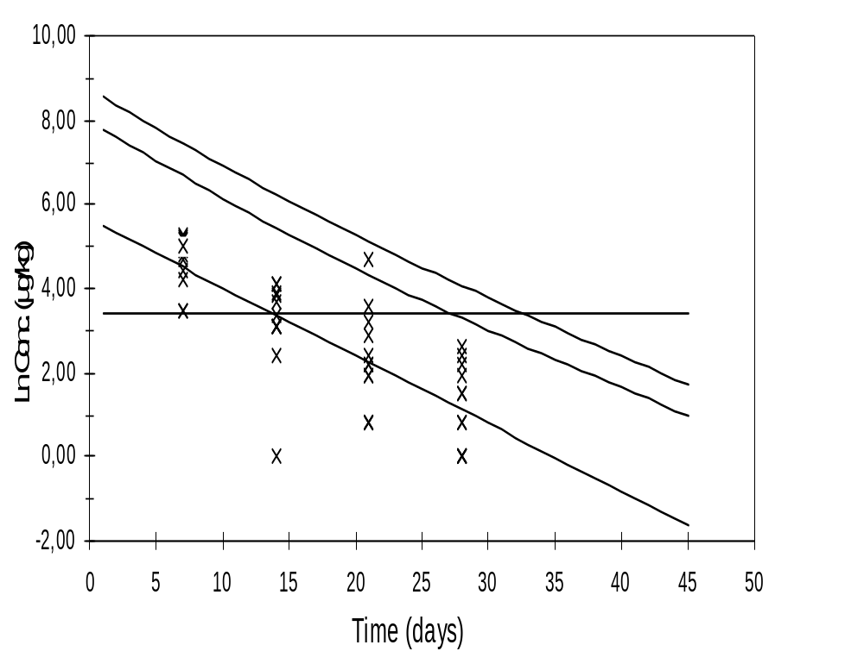
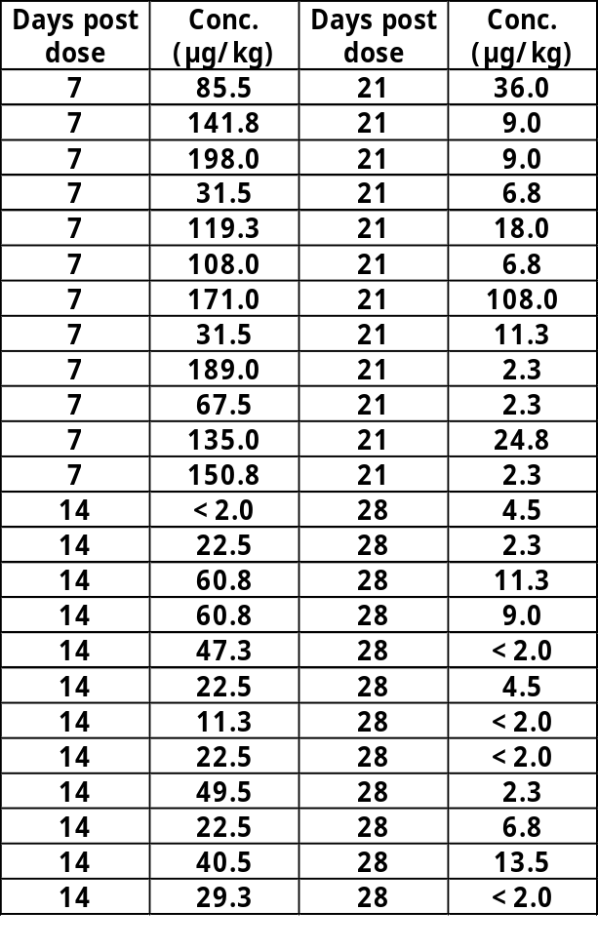
Example for assessment of data
(outside the scope of VICH 48)
28 days WP

Slide 20

VICH GL 48: “Marker residue
depletion” and withdrawal period
Study Design Milk
At least 20 lactating animals (high yielding animals at an early lactation stage and low yielding animals at a late lactating stage)
Intra-mammary administration for either lactating animals or dry-cow treatment all 4 quarters should be treated
For dry cows, treatment consistent with the desired pre-calving interval (dry period) so that a sufficient number of animals give birth in a limited time interval
All studies: Four-quarter composite samples should be collected from individual cows at each time point
12 hour collection intervals represent the most common milking frequency
20

Slide 21
VICH GL 48: “Marker residue
depletion” and withdrawal period
Study Design Milk - 0-day (nil) milk withdrawal time
For products administered as one/several treatment(s) or continuous treatment when residues have reached stea:dy state
A limited time point study sufficient to qualify for a 0-day (nil) milk withdrawal period
Sampling for a 0=day (nil) withdrawal time should be cover the earliest possible time points of post-treatment milking
Possible local differences for milking of cows can vary from as short as every 6 hours (4 per day) to every 24 hours (1X per day)
A specific study design has been developed for drugs that qualify for a zero-day withdrawal
A minimun of 16 animals is recommended, subdivided into three groups (Group 1: n=, Group 2: n=3, Group 3: n=10.
21

Slide 22
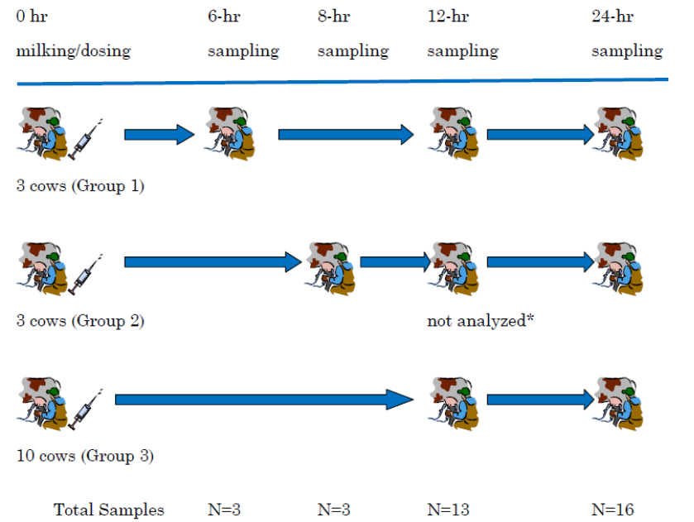
VICH GL 48: “Marker residue
depletion” and withdrawal period
Study Design Milk -
Sampling for “0-Day” (nil) milk withdrawal time claim

Slide 23
VICH GL 48: “Marker residue
depletion” and withdrawal period
Study Design Milk –
Recommendations 0-day (nil) milk withdrawal time
0-day milk withdrawal designation can be achieved based solely on this study design (provided sufficient information available to determine Cmax)
Milk collection at 12 hours after administration represents the maximum sampling interval which may still qualify for a 0-day (nil) withdrawal period designation
Strongly recommended that at least 4 additional samples be collected following the 12 hour sampling time to confirm that residue concentrations do not increase
23

Slide 24
VICH GL 48: “Marker residue
depletion” and withdrawal period
Study Design Milk – Intramammary Treatment (dry-cow)
All 4 quarters should be treated
For dry-cow treatment studies, the test article should be administered after the milking (dry-off), consistent with the desired pre-calving interval
Dry-cow studies comprise both a milk residue depletion phase (post-calving) as well as a decision on a desired pre-calving treatment interval
In order to reduce variability, the study should be designed such that a sufficient number of animals give birth in a limited time interval (i.e. the differences between dry periods among animals within an experiment should be kept as small as possible)
For instance, to target a pre-calving treatment interval of 30 days, data should be collected for, at least 20 cows calving between, for example, 20-30 days after treatment. Or between 40-60 days after treatment for a pre-calving treatment interval of 60 days
24

Slide 25
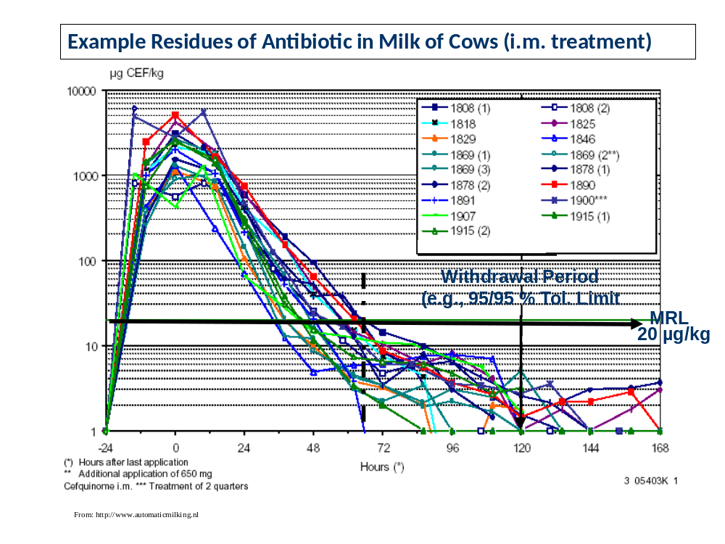
VICH GL 48: “Marker residue
depletion” and withdrawal period
Study Design Milk – Intramammary Treatment (dry-cow)
All 4 quarters should be treated
For dry-cow treatment studies, the test article should be administered after the last milking (dry-off), consistent with the desired pre-calving interval
Dry-cow studies comprise both a milk residue depletion phase (post-calving) as well as a decision on a desired pre-calving treatment interval
In order to reduce variability, the study should be designed such that a sufficient number of animals give birth in a limited time interval (i.e. the differences between dry periods among animals within an experiment should be kept as small as possible)
For instance, to target a pre-calving treatment interval of 30 days, data should be collected from at least 20 cows calving between, for example, 20-30 days after treatment. Or between 40-60 days after treatment for a pre-calving treatment interval of 60 days
24

Slide 26

VICH GL 48: “Marker residue
depletion” and withdrawal period
Study Design Eggs
Study design/Sampling
Egg samples obtained from 10 or more laying hens at every laying time point during the medication period and after the final medication
Eggs samples collected after the period necessary to complete egg yolk development which is usually up to 12 day
Egg white and yolk combined for analysis

Slide 27
VICH Guidelines 46, 47 and 49 - interrelationship of the residue guidelines
VICH GL46: Metabolism study to determine the quantity and identify the nature of residues
VICH GL47: Comparative metabolism studies in laboratory animals
VICH GL49(R): Validation of analytical methods used in residue depletion studies
These GLs:
The 4 basic VICH residue guidelines build on each other
VICH GLs 46, 47 and 49 provide the information on metabolism & residue depletion needed to set the MRL
They allow selection of the marker residue (for which the MRL is defined)
They are used to determine design elements for the marker depletion study/withdrawal time study
Provide information for sampling of additional (regional) tissues for the withdrawal period
Describe the validation parameter for residue studies

Slide 28

Additional VICH Guidelines: VICH GL46
VICH GL 46 provides guidance on studies to investigate:
Quantity and nature of residues
Depletion of “residue of concern” from edible tissues
Composition of the “residue of concern” in edible tissues
Identification of a target tissues for residues
Identification of the residue(s) that can serve as a marker for analytical methods
These studies provide the information needed for an exposure assessment and the risk characterisation AND for the design of future residue studies
29

Slide 29
Additional VICH Guidelines: VICH GL46
VICH GL 46 provides guidance on studies to investigate:
Quantity and nature of residues
Depletion of “residue of concern” from edible tissues
Composition of the “residue of concern” in edible tissues
Identification of a target tissues for residues
Identification of the residue(s) that can serve as a marker for analytical methods
These studies provide the information needed for an exposure assessment and the risk characterisation AND for the design of future residue studies
29

Slide 30
Additional VICH Guidelines: VICH GL46
Basic design elements
Studies typically accomplished using radio-labeled drug (total residue studies)
Carbon-14 is the label of choice because intermolecular exchange is not an issue (other isotopes, such as 3H, 32P, 15N or 35S might be appropriate)
The formulation of the drug should be as similar as possible to the intended final formulation
Alternative approaches (i.e. not using radiolabeled drug) to characterise the components of the residue in food derived from treated animals might be suitable (e.g. measurement of individual metabolites, screening/characterisation of metabolites by MS techniques)
30

Slide 31
Additional VICH Guidelines: VICH GL46
Four groups of animals
Large animals (cattle, swine, sheep): ≥3 per group
Poultry: ≥3 per group
Lactating cattle for milk collection: ≥8
Laying birds for egg collection: number sufficient to collect ≥10 eggs
For drugs for which a withdrawal period is not anticipated, time points should reflect “practical zero withdrawal”
  0-2, 3-4, and 6 hours for poultry
  0-3, 6-8, and up to 12 hours for large animals
  up to 12 hours for milk
Basic design elements
31

Slide 32
Additional VICH Guidelines: VICH GL46
Recommendations for metabolite characterisation – “major/minor” metabolites
Major metabolites typically are those comprising 100 μg/kg or 10% of the total residue in a sample collected at the earliest time point
Major metabolites typically need to be characterised/structural identified, e.g. using a combination of techniques - chromatographic/mass spectrometry
Ordinarily, no differentiation of metabolites below these levels (i.e. of the minor metabolites) recommended unless there are concerns over the nature of residues occurring at the lower levels
In some cases, chemical characterisation rather than unequivocal structural identification for a major metabolite will be appropriate (e.g. when a conjugate is present or if mass spectrometry information indicates the likely biotransformation pathway)
32

Slide 33

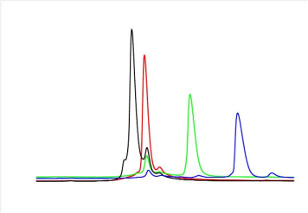


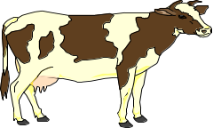
Additional VICH Guidelines: VICH GL46
Establish ADME and mass-balance
Determine Total Radioactive Residues (TRR) and residue depletion kinetics of TRR in edible tissues
Identify target tissue(s) for residues
Identify metabolic profile(s) in tissues
Identify a potential marker residue
(radio)labelled substance
°°°
°°°
°°°
°°°
°°°
Treatment
Post Treatment
33

Slide 34
Additional VICH Guidelines: VICH GL49(R)
Validation of analytical procedures used in residue studies
Not intended to define criteria for validation of regulatory monitoring procedures
The intent is that methods validated according to this guidance will provide residue data that would generally be considered acceptable
34

Slide 35
Additional VICH Guidelines: VICH GL49(R)
Performance characteristics to be addressed:
Linearity
Accuracy
Precision
Limit of Detection (LOD)
Limit of Quantitation (LOQ)
Selectivity
Stability in Matrix/Process Sample Stability
Robustness
35

Slide 36
Additional VICH Guidelines: VICH GL49(R)
Linearity:
Calibration curve typically shows linear relationship across the range of the expected matrix (tissue, milk, egg or honey)
Linearity can be described by a linear, polynomial or other (as appropriate) regression plot of known concentration vs. response using a minimum of 5 different concentrations
Calibration standard curves can be generated in three formats depending upon the methodology:
  standards in solvent/buffer,
  standards fortified into control matrix extract and standards fortified into control matrix and
  processed through the extraction procedure
36

Slide 37
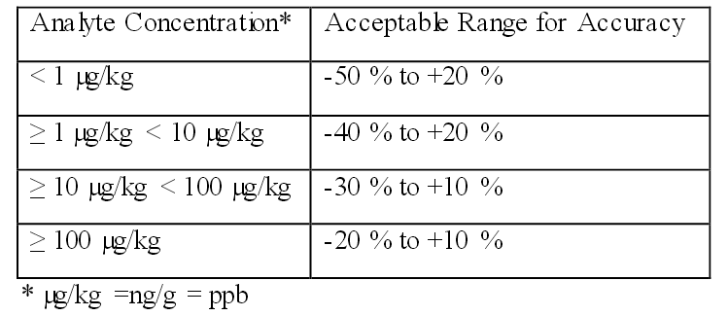
Additional VICH Guidelines: VICH GL49(R)
Accuracy:
Closeness of agreement between the true concentration of analyte and the mean result that is obtained by applying the experimental procedure
Accuracy is closely related to systematic error (analytical method bias) and analyte recovery (measured as percent recovery)
Recommended accuracy for residue methods will vary depending upon the concentration of the analyte
37

Slide 38
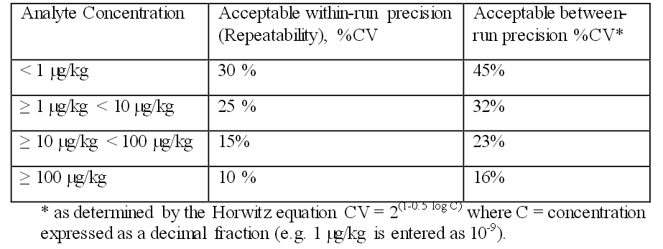
Additional VICH Guidelines: VICH GL49(R)
Precision:
Closeness of agreement between independent test results obtained from homogenous test material
Within- and between-run precision should be determined by the evaluation of a minimum of three replicates at 3 different concentrations representative of the intended validation range (which should include the LOQ) across three days of analysis
38

Slide 39
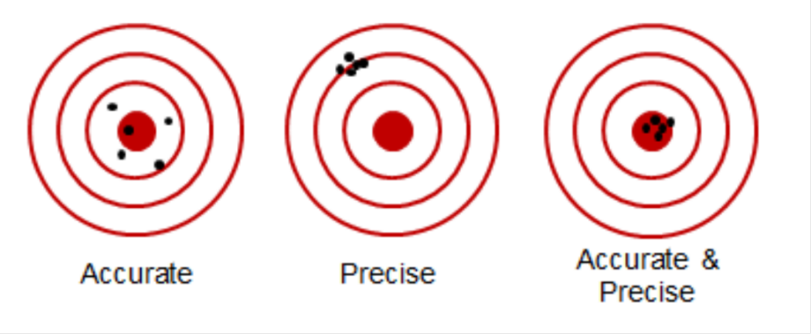
Additional VICH Guidelines: VICH GL49(R)
39

Slide 40
Additional VICH Guidelines: VICH GL49(R)
Limit of Detection:
The limit of detection (LOD) is the smallest measured concentration of an analyte from which it is possible to deduce the presence of the analyte in the test sample with acceptable certainty
Limit of Quantitation:
The LOQ is the smallest measured content of an analyte above which the determination can be made with the specified degree of accuracy and precision
40

Slide 41
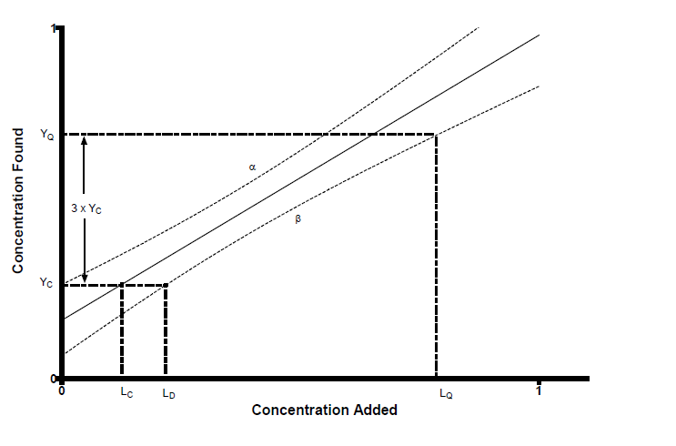
Additional VICH Guidelines: VICH GL49(R)
Example for graphical method to determine LOD and LOQ:
Y_{q}
Y_{c}
L_{C}
L_{Detection}
L_{Quatitation}
Quantification limit (LQ), decision limit (Lc) and detection limit (LD) in a graphical representation
The LOQ (LQ), may be obtained by multiplying the detection limit (YLD) by 3 (commonly accepted ratio between LOD and LOQ is 3)
The LOQ (LQ) is then where the line YQ crosses the lower confidence limit
41

Slide 42
Additional VICH Guidelines: VICH GL47
Demonstration of comparability of metabolites from the laboratory animal and target animal
Question to be answered: Did the toxicological testing in laboratory species evaluate the right compound(s)?
Qualitative evidence that laboratory (“tox”) species from which the ADI has been derived was exposed to the same residues to which humans may be exposed when they consuming products from treated animals sufficient
The VICH GL 47 study can be generally accomplished in an in-vivo study or one or more in-vitro studies
If profiles are not comparable, the ADI cannot be applied and more toxicology testing may be necessary (!)

Slide 43
Summary Data Requirements and Concept for establishing MRL and Withdrawal Period
Total residue depletion data in target species (VICH GL46)
Comparative metabolism data (VICH GL47)
Marker residue data in target species (VICH GL48)
Residue analytical methods (VICH GL49)
And of course:
Acceptable Daily Intake (ADI) or comparable reference value
Note: analytical methods for residue control/surveillance are not with the scope of VICH

Slide 44
Concept for establishing an MRL –
Typical Risk Characterisation Step

Slide 45
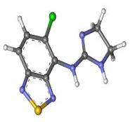
Overall Concept for establishing MRL and Withdrawal Periods
Parent+ (e.g,
Conjugates)
Metabolite 1
Metabolite 2
Exposure/ADI < 1
Marker
Residue
MRL
Withdrawal Period
Metabolite 3
Unidentified
Unidentified Bound
Risk Characterisation
Point of Departure (POD)
Residue
Profile

Slide 46
With special thanks to:
Stefan Scheid
Federal Office of Consumer Protection and Food Safety (BVL)
Berlin, Germany
Dept. 3: Veterinary Drugs
Unit 305: Residues of Pharmacologically Active Substances

